Slide 1
CSE 208 Fall 2018 Project
Gabriel Almeida, Irwin Cayo, Ashraf Drieas, Brandon Fins, Juan Inzunza, Clifton Rawlings

Slide 2
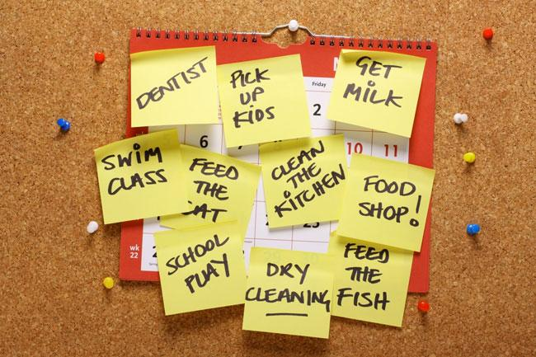
Ask yourself...
Notes:
Gabe’s slide. Have you ever wanted more plants in the house but your busy schedule has you spending a lot of time away from home?

Slide 3
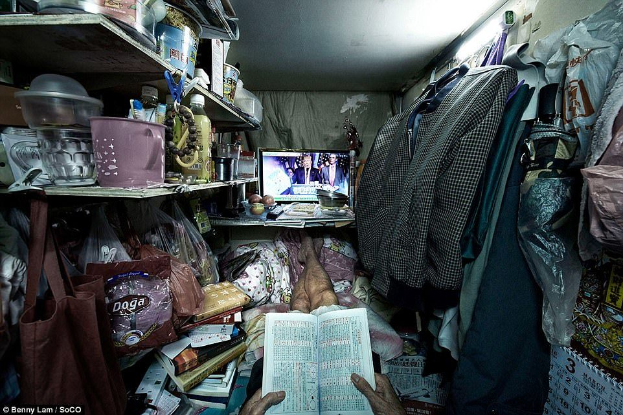
Ask yourself...
Notes:
Gabe’s slide. Do you live alone or in a small space with no outdoor area for greenery?

Slide 4
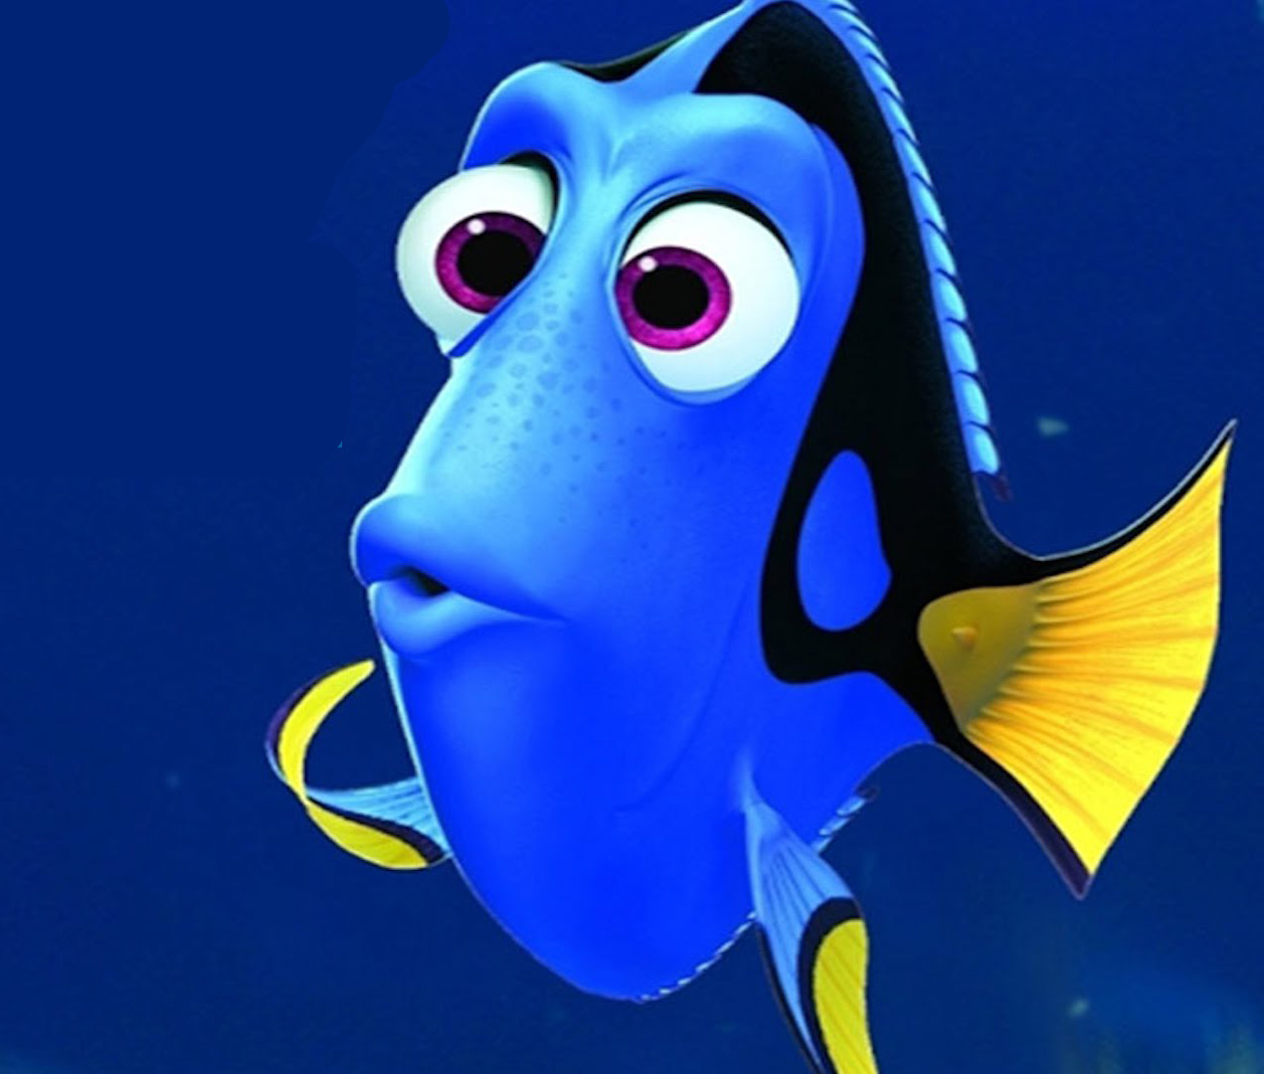
Ask yourself...
Notes:
Gabe’s slide. Do you have a poor memory and often forget to water your indoor plants?

Slide 5
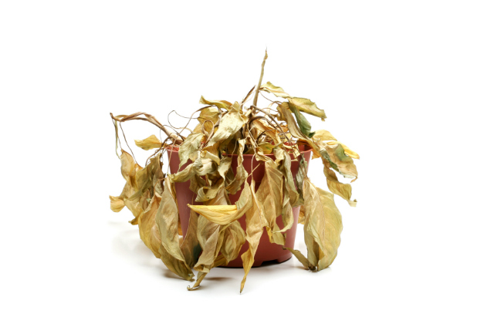
Ask yourself...
Notes:
Gabe’s slide. Have you ever gone on vacation and come back to dead or dying plants?

Slide 6
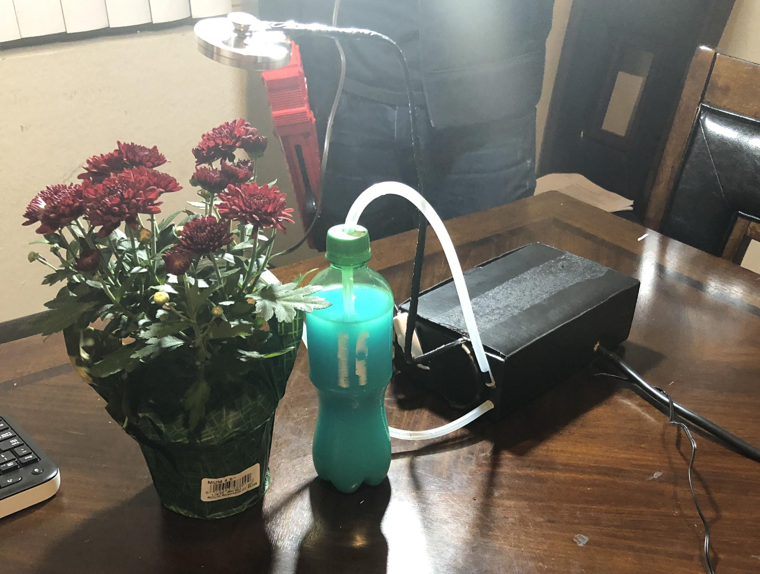
The Automatic Pi-Dration System
New programmable watering and sunlight system
Don’t worry about watering again
Set it and forget it
Notes:
Gabe
Introducing...the Automatic Pi-dration system!

Slide 7
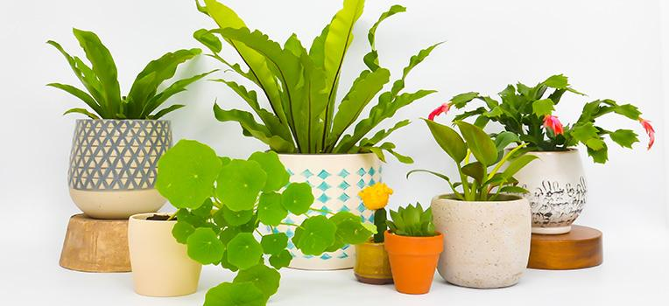
The Automatic Pi-Dration System
Perfect for those looking to start or improve their gardening skills.
It’s never been easier to look after your precious plants.
Not to mention your garden will stand out from your friends and family.
Notes:
Gabe

Slide 8
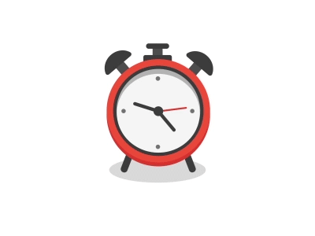
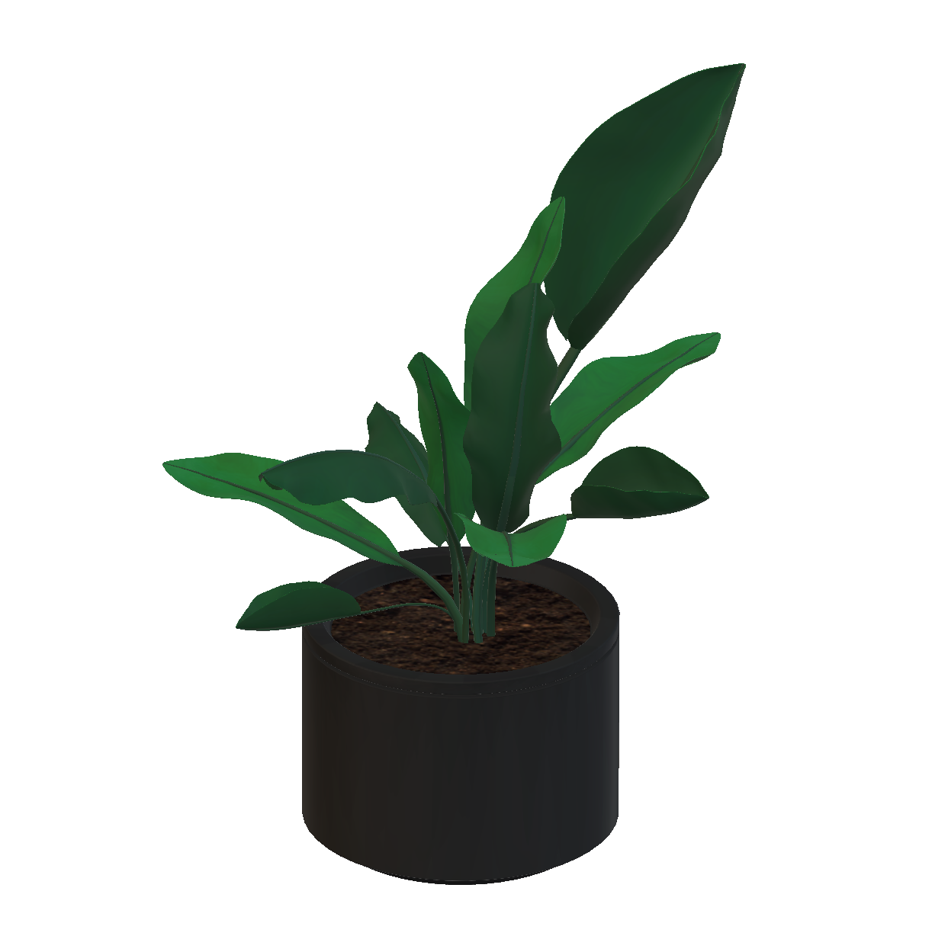


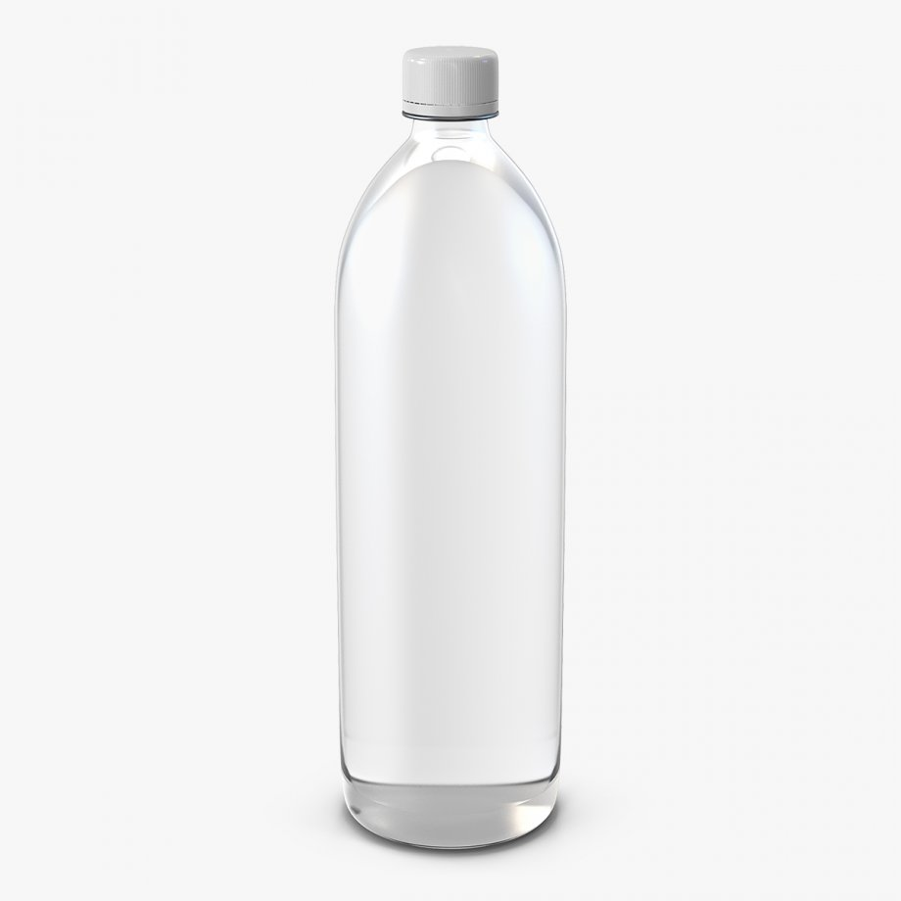
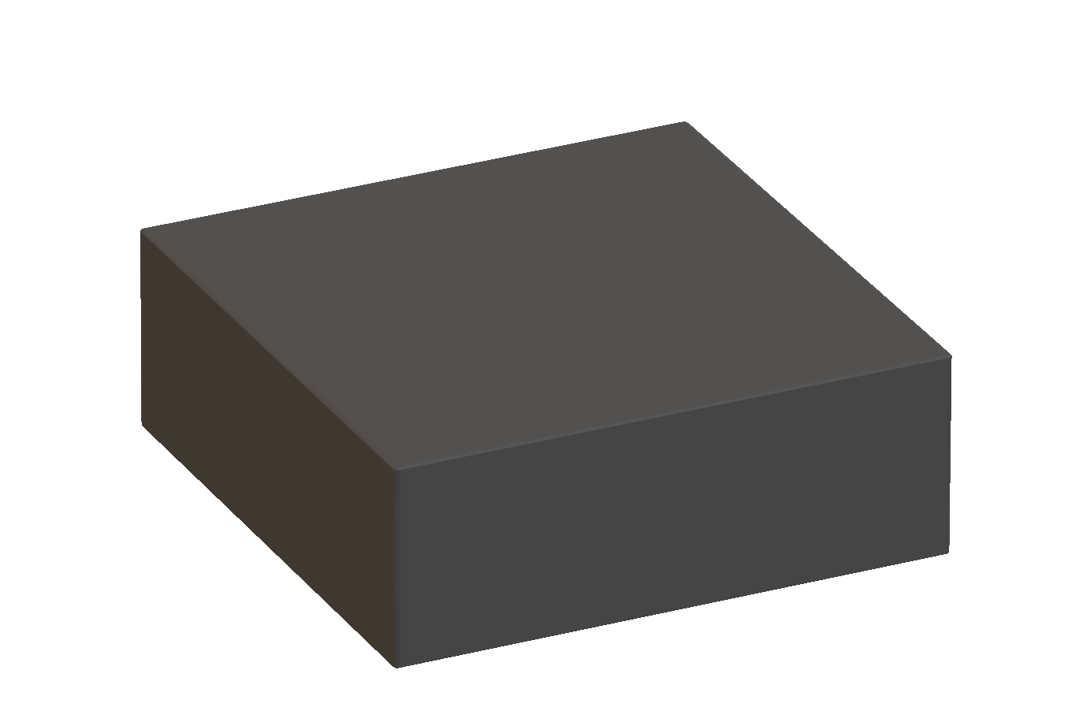
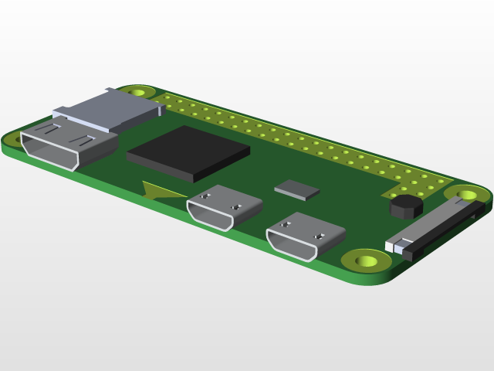

How does it work?
Vacuum tubing
Notes:
Eddie
Give an overview of the entire system

Slide 9
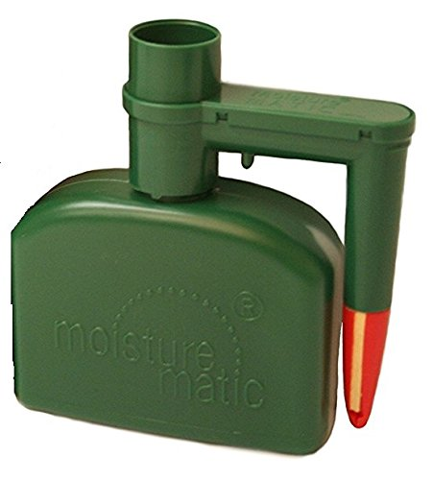
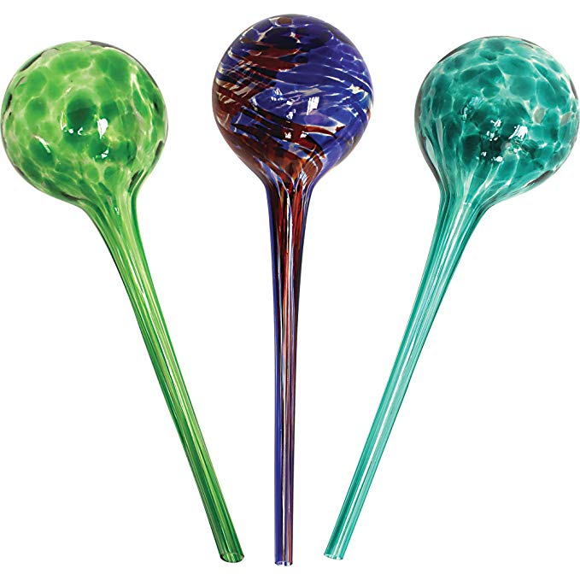
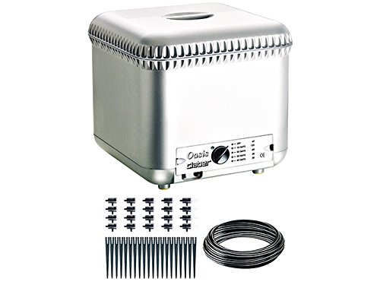
Products already on the market
Notes:
Brief overview of other systems on market:
Some systems are placed in the soil of a plant and attached to some sort of reservoir system
In similar fashion, self-watering pots have a reservoir in the bottom of the container that provides a constant source to water for the plant to use
Drip waterers and watering timers are controlled with timers, and can be placed in the soil of large or medium-sized gardens and either drip or spray water into the plant based on the timer settings. These systems require a hose system that is connected to some constant water source such as a faucet.

Slide 10
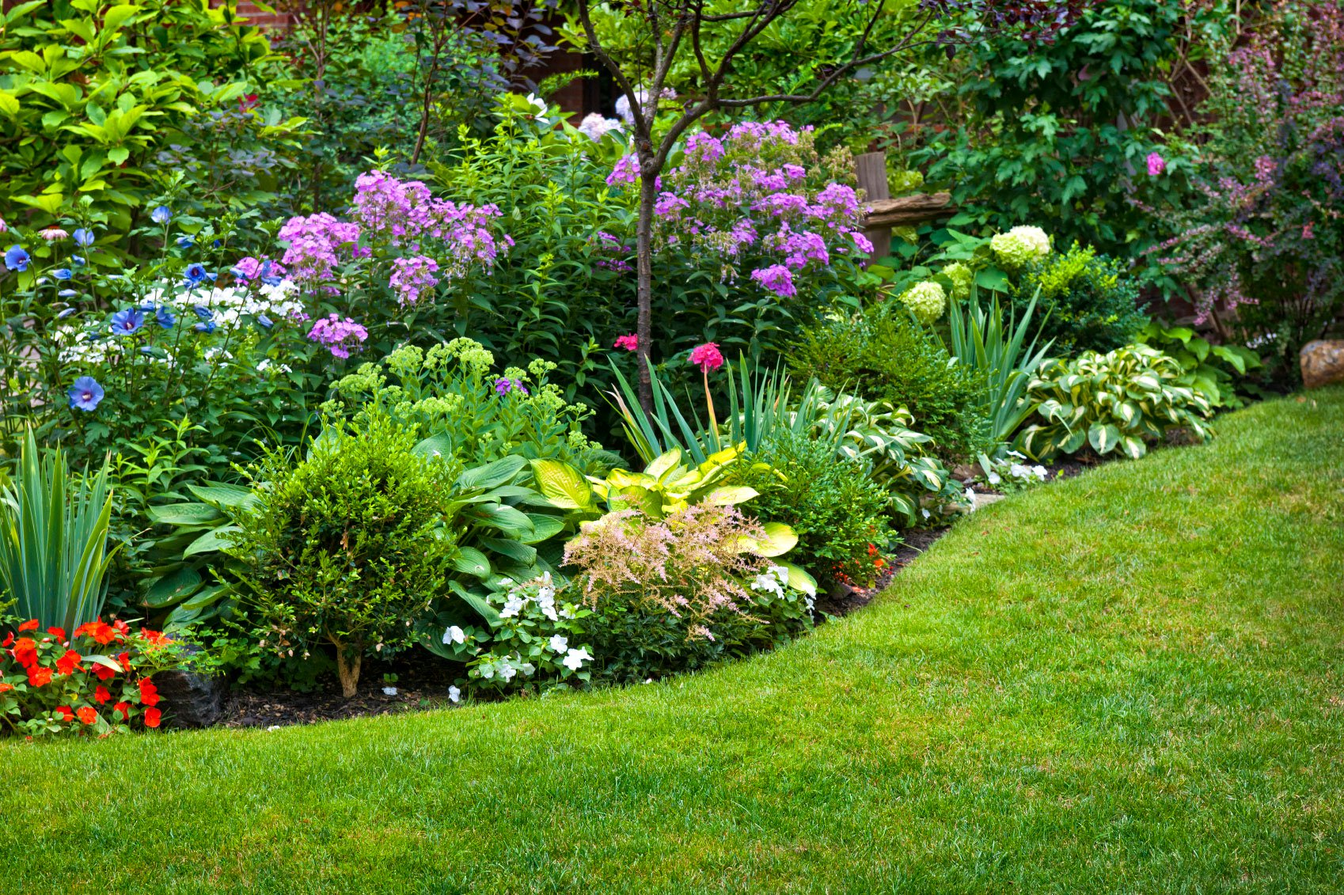
Project Goal
To improve the efficiency of maintaining a plant/garden while reducing the need for human involvement.
Notes:
Juan’s slide - The reason behind our project

Slide 11
Why use The Automatic Pi-Dration System
Compact and easy to use
Versatile and Multiple Functionality
Allows user customization
Competitively priced
Other devices are pricey and limited to features
Similar devices are clunky and aren’t very practical
Notes:
Juan’s slide -
Doesn’t take much skill to use. A good product is user friendly

Slide 12
Device Capabilities
The ability to be used on any plant regardless of size
Gives you the piece of mind of providing both water and light
Allows the freedom to customize schedule based on user wants and needs
Notes:
Brandon

Slide 13
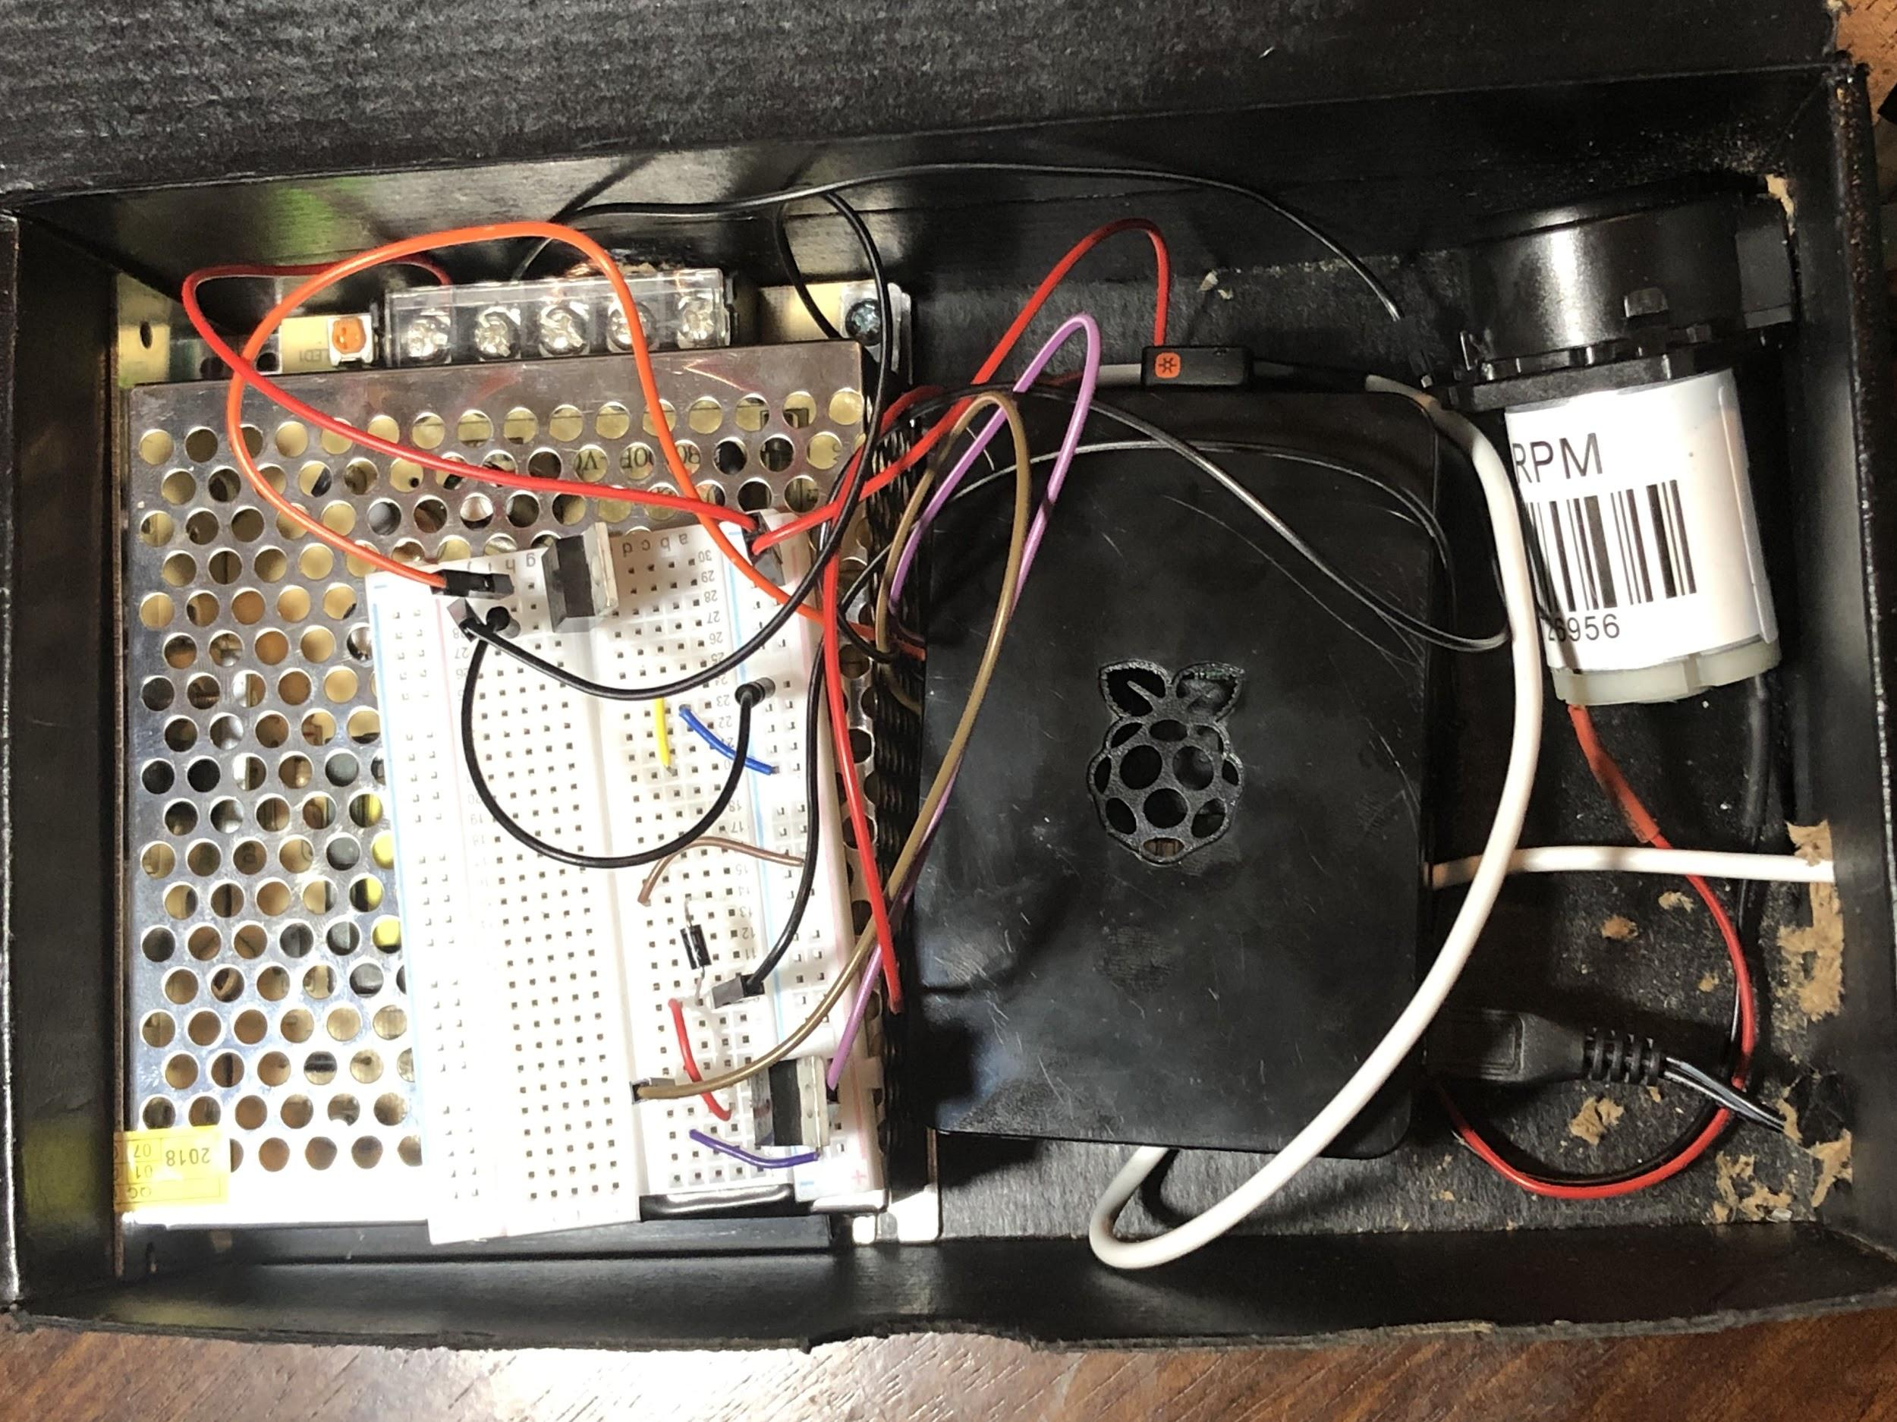
Hardware Components
Raspberry Pi 3 B+
12V Water Pump
5V UV light
2 MOSFET Transistor
Diode
12V AC/DC Power Converter
Breadboard and Wires
Notes:
Brandon

Slide 14



Video Demonstration
https://drive.google.com/file/d/1FMASxqEhVNgp9EUKeb2SqJrr7jNqs-Ia/view?usp=sharing

Slide 15
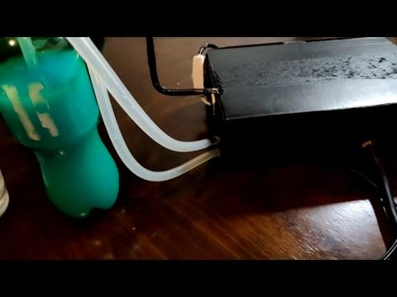

Slide 16
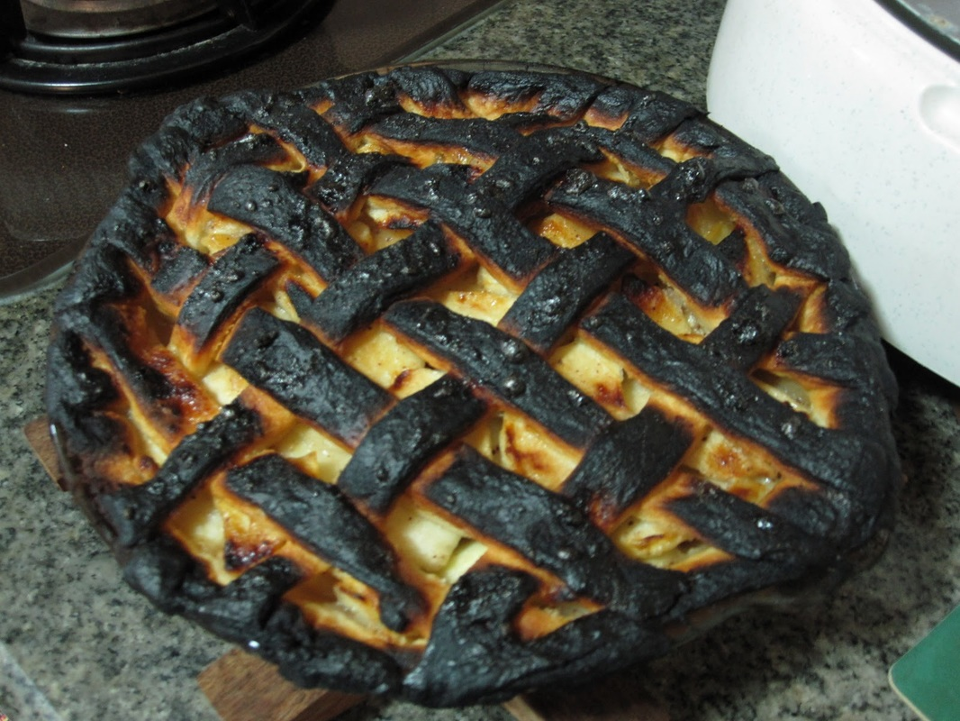
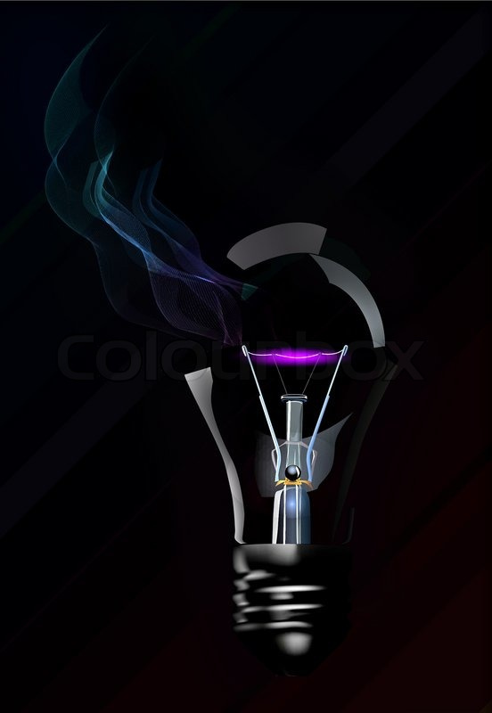
Difficulties/Problems
How to supply 12V to the water pump without frying the Pi
Finding a suitable light which runs on the provided power and method of current(DC not AC)
Notes:
Cliff

Slide 17
Potential Future Improvements
Cost reduction - With further research and development
Added Features - Ability to use on multiple plants, Portable LCD Display, Humidity and light sensor
Appearance and Construction - Improve look of design, Use better quality materials
Notes:
Gabe

Slide 18

Questions

